Slide 1
Tech Sentinel
AI Driven Cyber Defense

Slide 2
What is the AI Cyber Defense Platform?
As cyber threats grow more complex, traditional defense systems fall short.
Tech Sentinel is a unified, AI-powered cybersecurity dashboard that integrates real-time threat detection, intelligent data protection, and secure scanning capabilities — delivering a proactive and adaptive security solution.
Key Features
🔹 SMS Spam Detection: Classifies spam and phishing messages using a machine learning pipeline (TF-IDF + ML model).
🔹 Threat Detection (.arff Network Logs): Analyzes intrusion datasets using trained classifiers to flag attacks and anomalies.
🔹 Image Steganography: Encrypts and hides sensitive messages inside images with password protection for covert communication.
🔹 Live URL & File Scanning: Leverages global threat intelligence to detect malicious content in real-time.
🔹 PE File Scanner: Predicts malicious or benign nature of .exe/.dll files using static feature analysis.
🔹 File Hash Checker: Matches file hashes against the VirusTotal database for known malware signatures.
🔹 Port Scanner: Identifies open/closed ports on a target host — useful for basic vulnerability assessment.
🔹 PCAP Analyzer: Extracts, displays, and summarizes packet-level network data for traffic analysis.

Slide 3
Problem Statement
In today’s hyper-connected world, individuals and organizations face an alarming rise in sophisticated cyber threats — from phishing and malware to SMS-based scams and data breaches. Traditional security systems often lack the intelligence and adaptability required to counter these evolving threats effectively.
Key Challenges Addressed by Tech Sentinel
🔴 SMS-Based Phishing & Spam Attacks
Malicious messages manipulate users into disclosing personal or financial data.
🔴 Inadequate Threat & Malware Detection
Legacy tools struggle to detect new, fast-evolving attack patterns.
🔴 Data Privacy & Secure Transmission
Sensitive information lacks safe channels for covert storage and communication.

Slide 4
Requirements Engineering
✅ Functional Requirements
User Login & Authentication
SMS Spam Detection (AI Models)
Threat Detection from ARFF Files
PE File Malware Classification
Image Steganography (Encryption & Decryption)
Live URL & File Scanning (VirusTotal)
File Hash Checker
PCAP Packet Analyzer
Port Scanning
⚙️Non-Functional Requirements
Security: Password hashing, data privacy, encryption
Performance: Fast prediction, optimized models
Usability: Clean UI, user-friendly design
Scalability: Modular system for future tools
Portability: Cross-platform (Windows/Linux)
Reliability: Error handling & fallback logic
🔁 Modular | Secure | AI-Integrated

Slide 5
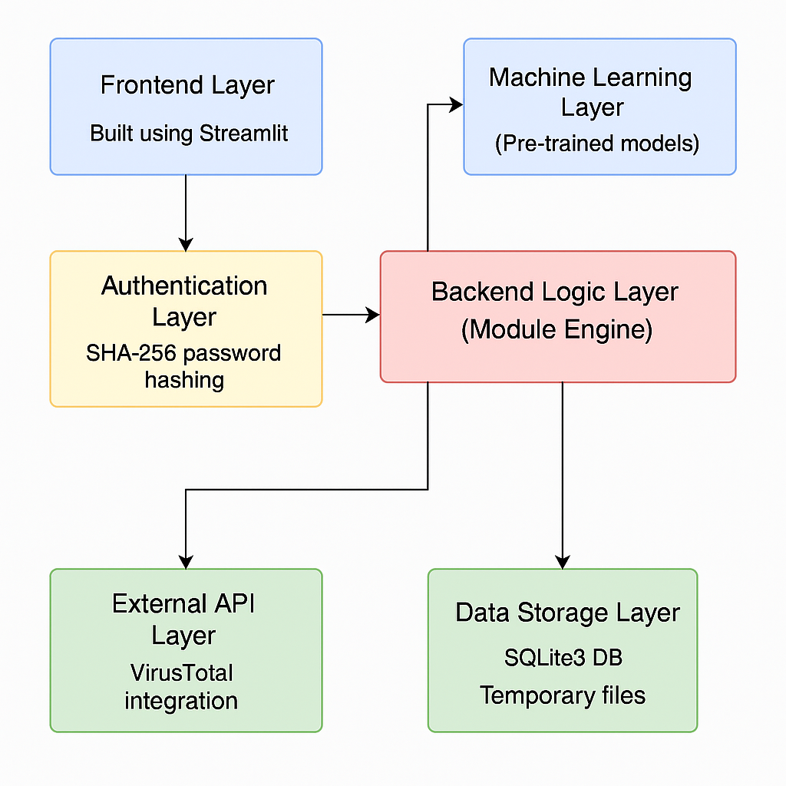
Design & Development
System Architecture:

Slide 6
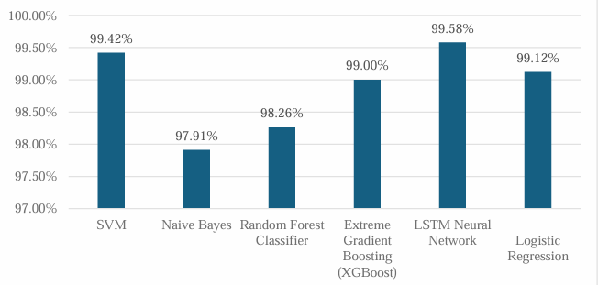
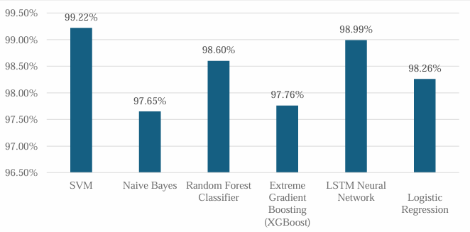
SMS Spam Classification using Machine Learning
Training accuracy
Architecture:
Data Collection: UCI SMS Spam Collection dataset
Preprocessing: Text cleaning, tokenization, stop-word removal, TF-IDF vectorization
Model Training: Algorithms like Naïve Bayes, Logistic Regression, SVM, Random Forest, LSTM
Evaluation: Accuracy, Precision, Recall, F1-score
Deployment: Flask API / Stream lit for user interface
Dataset:
Source: UCI Machine Learning Repository
Size: 5,574 messages
Labels: Ham (Legitimate) or Spam
Testing accuracy

Slide 7
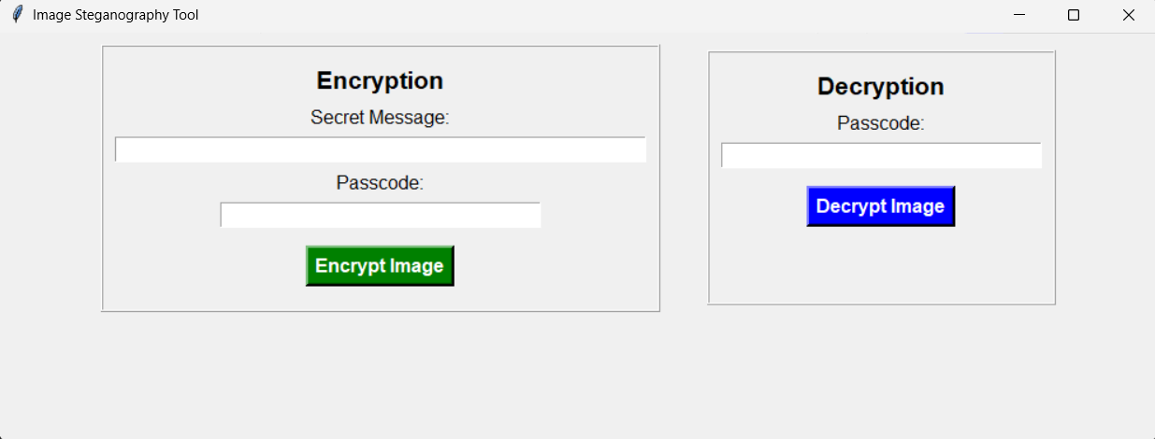
Secure Data Hiding Using Image Steganography
Architecture:
Data Input: User provides a secret message and selects an image for encryption.
Encryption Process:
  Message is hashed for security.
  The hashed message is embedded into image pixels using Least Significant Bit (LSB) steganography.
Image Storage: The encrypted image is saved for secure transmission.
Decryption Process:
  The receiver enters a password.
  If correct, the hidden message is extracted and displayed.
Dataset:
Type: Custom dataset (Images + Encrypted text messages)
Storage Format: PNG/JPEG images with hidden text
Security: Uses SHA-256 hashing for authentication

Slide 8
AI-Powered Threat Detection
Architecture:
Data Collection: Uses the KDDTest+ dataset for network intrusion detection.
Preprocessing:
  Categorical feature encoding using Label Encoding.
  Feature scaling using StandardScaler.
Model Training:
  Random Forest Classifier for anomaly detection.
  Deep Neural Network (DNN) for improved accuracy.
Evaluation:
  Performance metrics: Accuracy, Precision, Recall, F1-score.
Detection & Alerting: Predicts whether network traffic is normal or an attack.
Dataset:
Name: KDDTest+ (KDD Cup 1999)
Size: Over 125,000 network traffic records
Attack Types: Denial-of-Service (DoS), Probe, R2L, U2R
Classes: Normal (0) or Attack (1)

Slide 9
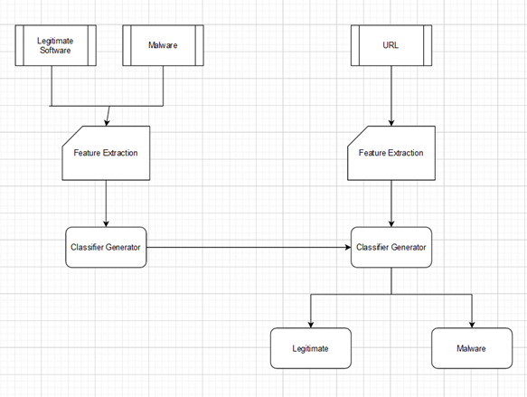
Malware Detection
Architecture
The system takes URLs and Portable Executables (PE) as input.
It extracts features from these inputs for analysis.
Machine learning models are trained to classify malware vs. benign instances.
The system provides real-time detection and alerts based on model predictions.

Slide 10
1) Live URL Scanner (VirusTotal Integration)
Input: User enters a URL (e.g., website link)
Process: The system sends the URL to VirusTotal API using a POST request.
A unique analysis ID is generated and polled until the scan completes.
Output: Real-time scan verdict:
🔴 Malicious
🟡 Suspicious
🟢 Harmless
Displays scan stats and classification results within the app.
Use Case: Detect phishing websites, harmful redirects, and domains hosting malware.
Security: Only metadata is sent; URLs are not stored.
2) PE File Scanner
Input: User uploads a PE file (.exe or .dll)Process:
Static features (predefined list) are simulated/generated for demo.
Loaded into a trained Random Forest model for classification.
Output:🔴 Malicious if threat is detected
✅ Benign if safe
Use Case: Detect trojans, worms, or spyware in executable files.
Note: In a full implementation, a static/dynamic feature extractor would replace the placeholder

Slide 11
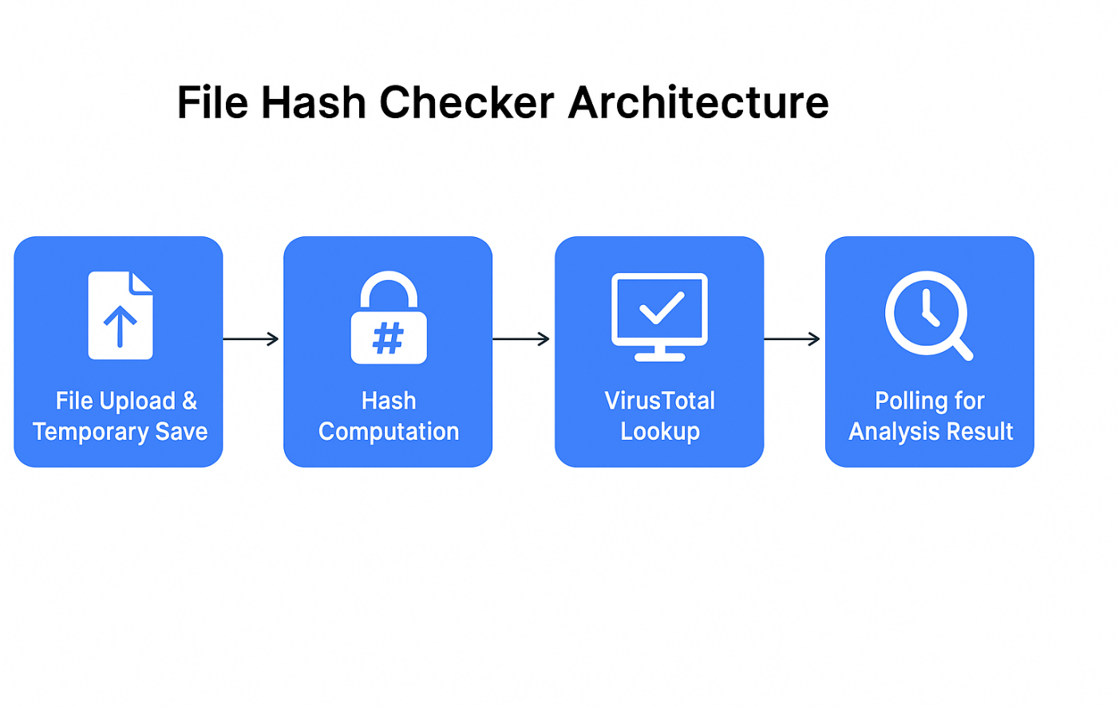
File Hash Scanner
Architecture:
📂 1. File Upload & Temporary Save
User uploads a file via Streamlit uploader
The file is written locally as tempfile in binary mode
⚙️ 2. Hash Computation
SHA-256 hash is computed using Python’s hashlib
File is read in chunks (8192 bytes) to avoid memory issues
🔍 3. VirusTotal Lookup
Uses VirusTotal API to check if the hash exists:
✔️ Found → Displays malicious/suspicious/harmless stats
❌ Not Found → Submits the file to VirusTotal for scanning
🔁 4. Polling for Analysis Result
If file is newly submitted: System polls VirusTotal 10 times (1s interval)Displays result when scan is complete (or timeout warning)
🔐 Security Features
File processed locally before upload
Uses official VirusTotal API with secure headers
Only SHA-256 is used for hash computation (secure & industry standard)
✅ Output:
Malicious / Suspicious / Harmless / Undetected counts
Full transparency of scan status and results

Slide 12
Port Scanner
Architecture:
Data Input:
  User inputs a target IP address or domain name.
  User selects a port range (e.g., 1–1024 or custom).
  Option to choose scan type (e.g., TCP connect scan or socket-based scan).
Scanning Process:
  The system performs socket-based port scanning.
    Attempts to establish a TCP connection to each port.
    Ports are marked as open, closed, or filtered based on response.
  Optionally supports multi-threading or async I/O for faster scans.
Result Interpretation:
  Open ports are listed along with common service names (e.g., 22 → SSH, 80 → HTTP).
  Results are displayed in tabular form, with visual cues (✔️ open, ❌ closed).
Security & Restrictions:
  Limits max scan range to prevent misuse (e.g., max 1000 ports).
  Scanning is local and cannot be used for external attacks.
  Warning is displayed for ethical use compliance.

Slide 13
PCAP Analyzer
System Architecture
🟦 Input
User uploads a .pcap or .pcapng file through the Tech Sentinel interface (Streamlit-based).
⚙️ Packet Parsing & Feature Extraction
Uses Scapy (or PyShark) to extract:
Packet metadata (source/destination IPs, protocols)
Port information
Packet count and sizes
🧠 Traffic Analysis
Computes:
✅ Total number of packets
✅ Protocol distribution (TCP, UDP, ICMP, etc.)
✅ Most frequent source/destination IPs and ports
✅ Potential anomalies (e.g., port scans, repeated requests)
📈 Output & Visualization
Displays a summary table of analyzed packets

Slide 14
Conclusion
The AI-powered cyber defense platform leverages machine learning and deep learning techniques to detect and mitigate cyber threats in real time. By analyzing URLs, Portable Executables (PE) files, and network traffic, the system efficiently identifies potential malware and phishing attempts. This automated approach enhances cybersecurity resilience by reducing manual effort, improving detection accuracy, and enabling proactive threat mitigation.

Slide 15
Future Work
Virus Total & Hybrid Analysis API Integration – Using online threat intelligence services for real-time malware scanning and classification.
YARA Rules Implementation – Enhancing detection by writing custom YARA rules for identifying malware patterns.
Real-Time Packet Inspection – Deploying deep packet inspection (DPI) to analyze network traffic in real-time.
Federated Learning for Threat Detection – Training AI models across multiple endpoints without centralizing sensitive data.
Blockchain for Threat Intelligence Sharing – Using decentralized networks to share threat data securely and prevent tampering.
GPU Acceleration for Faster Analysis – Leveraging high-performance computing for real-time inference with deep learning.
Behavioral Analysis with Sandboxing – Executing suspicious files in a virtualized environment to observe malicious behavior.
Zero-Day Threat Detection using AI – Implementing anomaly detection models to identify unknown cyber threats.
Automated Incident Response System – Deploying AI-driven playbooks to isolate threats and mitigate attacks instantly.
Edge AI for Endpoint Security – Running lightweight AI models on IoT devices and edge systems for instant detection and response.

Slide 16
References
[1] U. Bayer, P. Comparetti, C. Hlauschek, C. Kruegel, and E. Kirda, “Scalable, Behavior-Based Malware Clustering,” in NDSS, 2009.
[2] S. Pascucci, P. Ruiu, L. Satta, and R. A. Calvo, “Real-Time Malware Detection and Classification using Machine Learning,” IEEE Transactions on Information Forensics and Security, vol. 16, pp. 1–14, 2021.
[3] F. Raff, F. Kreuzberger, and R. Spahn, “Malware Detection by Behavioural Sandbox Analysis,” Journal of Cybersecurity, vol. 5, no. 1, pp. 1–12, 2020.
[4] J. Zuech, I. M. S. Albrecht, and T. G. Dietterich, “Machine Learning Strategies for Malware Detection,” ACM Computing Surveys, vol. 53, no. 2, pp. 1–36, 2021.
[5] VirusTotal API, “Automated Malware Scanning and Threat Intelligence,” [Online]. Available: https://www.virustotal.com/gui/home/upload, 2024.
[6] YARA Project, “YARA - The pattern matching Swiss knife for malware researchers,” [Online]. Available: https://yara.readthedocs.io/en/stable/, 2024.

Slide 17
Thank You!

